Slide 1
Intro to Natural Language Processing for Clinical Text
Matthew Engelhard

Slide 2
Predictive models for tabular data
y, associated value or label
x, data/features for a subject or patient
End goal: predict y from x
Notes:
Let’s take a moment to review what we discussed last time
Opportunity to answer questions, which we didn’t have before
We talked about the basics of a predictive model.
It takes a set of data, or features, x, and applies a mathematical function or logic to make a prediction about an associated value, y
The thing that takes x and returns the prediction about y – that’s the model, the ”machine” in machine learning.

Slide 3
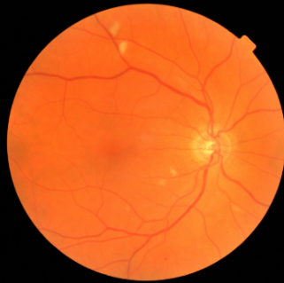
CNNs: predictive models for image data
y, referrable diabetic retinopathy
x, retinal image
End goal: predict y from x
Notes:
It’s just another predictive model.
But, we need a much more complex model to due to the complex, spatial structure of these data
Extract a hierarchy of increasingly complex features

Slide 4
NLP: predictive models for text data
y, abnormality present
x, radiology report
End goal: predict y from x
Notes:
Today, we’re going to consider a new kind of predictive model, one in which the input to the model is a text document, and the output is a label associated with that document
For example, the input might be a radiology report, and the output might be a binary label indicating whether an abnormal finding was noted in the report
But as we know, all our predictive models – logistic regression, MLP, CNN – they all work with numbers
So, right from the start we’re faced with a difficult problem – how can we convert a document into a feature vector that encodes its contents?
If we can do that, we can then apply any of the classification models we’ve previously discussed
So, that’s the problem we’ll be solving today.

Slide 5
Today: NLP and Model Interpretability
What can natural language processing (NLP) do, and how is it relevant to clinical medicine?
How does NLP work?
Methods based on word counts (“bag of words”)
Methods based on word vectors (including deep neural networks)

Slide 6
What can today’s NLP do?
Notes:
Stimulate discussion here

Slide 7
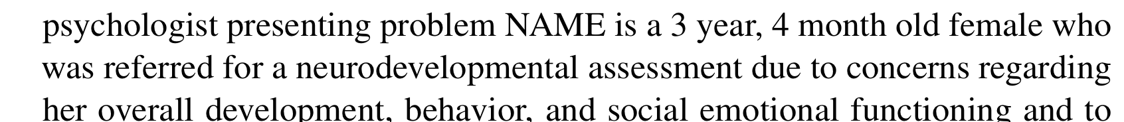
Classification and Regression
y, autism risk
x, clinical note
End goal: predict y from x

Slide 8

Case Study: SMS Triage for Global Maternal Health
Maternal Health HelpDesk:
2 million women connected to NDoH staff via SMS
https://www.praekelt.org
Binary Classification: Urgent Message? (Yes/No)

Slide 9
Why use clinical notes? Notes >> structured data for identifying diseases, procedures
Notes:
Here’s the key finding of a recent JAMIA paper focused on identifying cardiovascular diseases and procedures from EHR data
Each of these concepts was identified by chart review by clinical expert annotators
And then they train models to identify those concepts based on
(a) structured data – this is “EHR-S”
And (b) clinical notes – this is “EHR-U”
Their findings tell a pretty consistent and compelling story
Both approaches do pretty well in terms of precision – also known as positive predictive value – in other words, both models are usually right when they tell you they’ve identified one of these concepts
However, the recall – aka the sensitivity – is FAR better for the unstructured models
Very often, the structured data models miss it
And if you look through the details, they do a good job building these models
The issue is not the models themselves – it’s that the structured data very often doesn’t contain the relevant information. It’s only found in the notes.

Slide 10
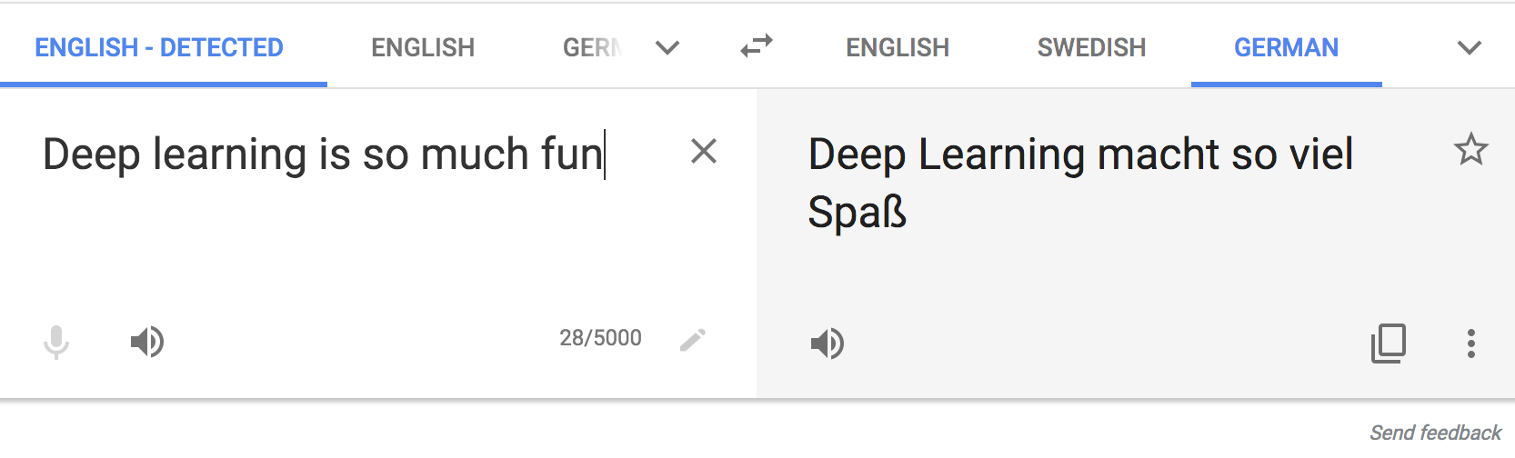
Text Translation
translate.google.com
Notes:
Input is a sequence
Output is a sequence

Slide 11
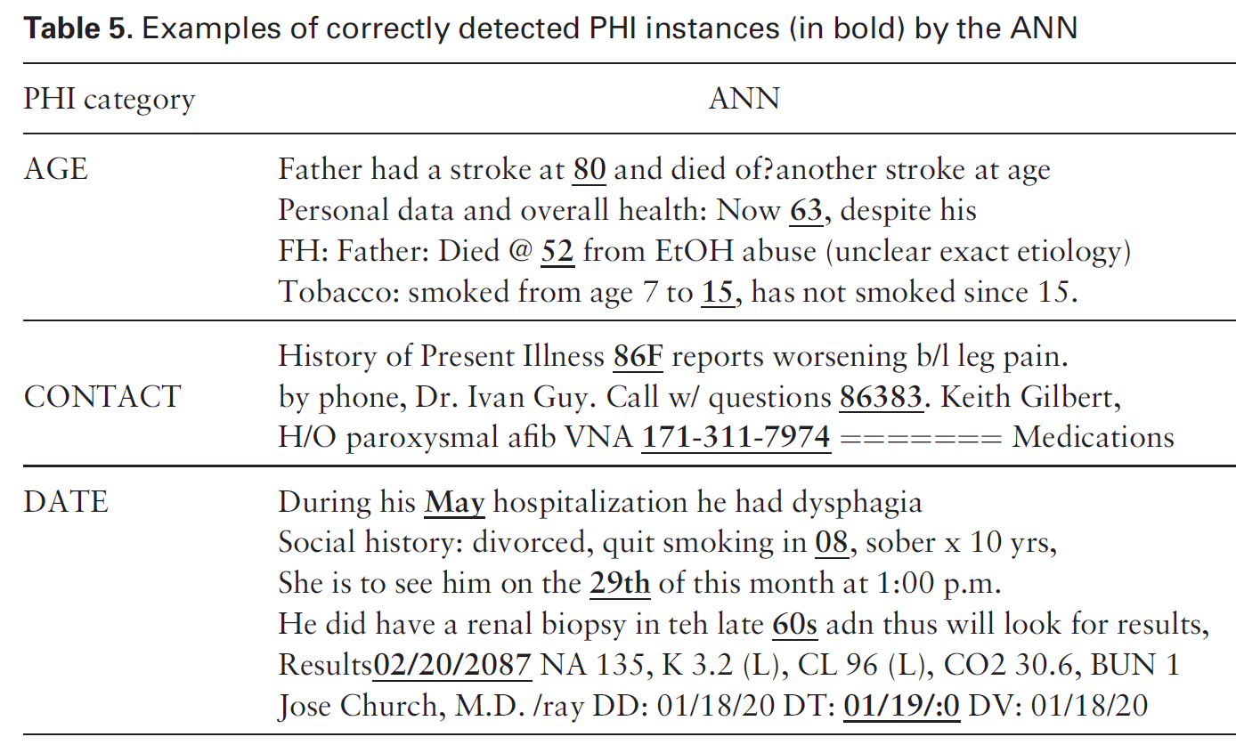
Text Translation --> De-Identify Notes
Mass effect from extradural hemorrhage
https://radiopaedia.org
De-identification of patient notes with recurrent neural networks
JAMIA 24(3), 2017, 596–606

Slide 12
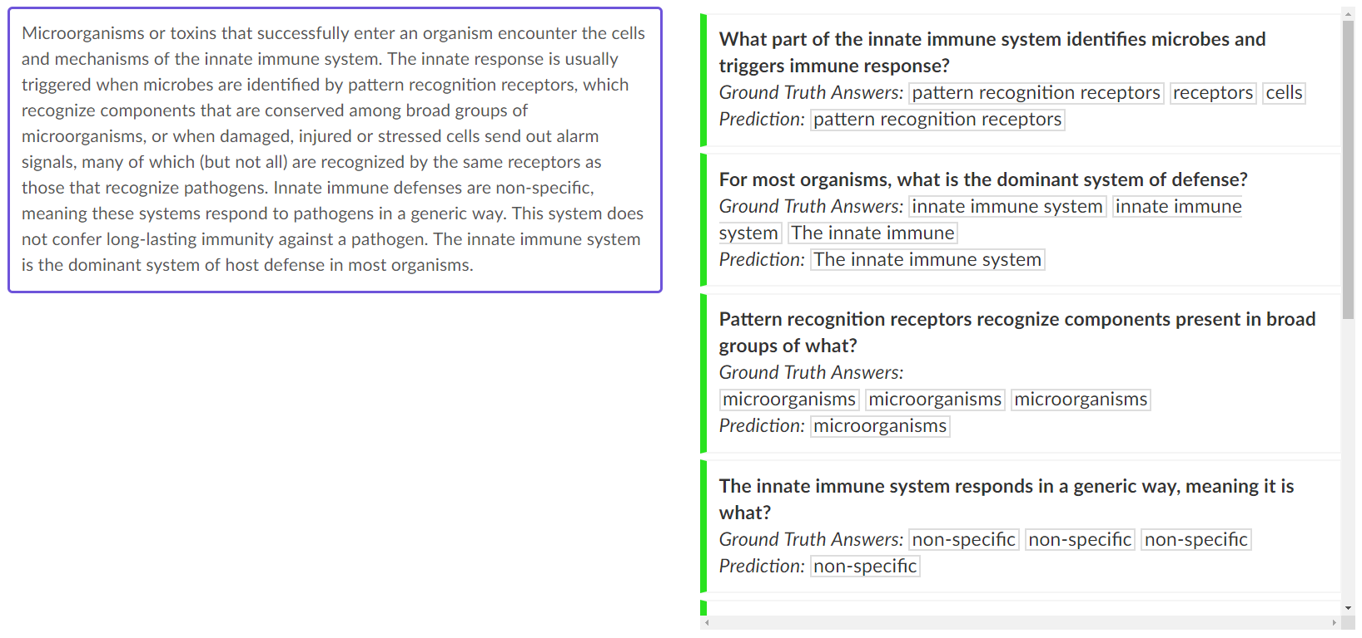
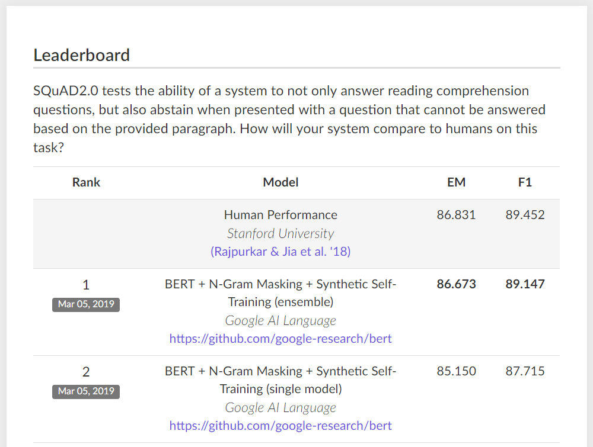
Question Answering
Notes:
Describe what is happening here.
How could something like this be used in healthcare?
Query the electronic health record. -> when was the patient first diagnosed with X?
When were symptoms / complaints related to Y first documented?

Slide 13
Question Answering --> Query the EHR
Notes:
Describe what is happening here.
How could something like this be used in healthcare?
Query the electronic health record. -> when was the patient first diagnosed with X?
When were symptoms / complaints related to Y first documented?

Slide 14
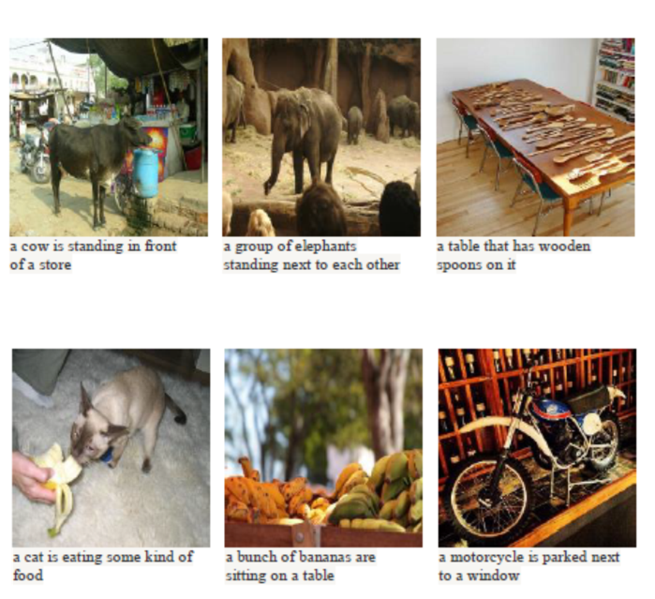
Automatic Image Captioning
Notes:
This is a little different from what we’re talking about today – more akin to image processing, as the input is an image
And we are not going to talk about text generation.
But imagine possibilities here: Think: radiology report

Slide 15
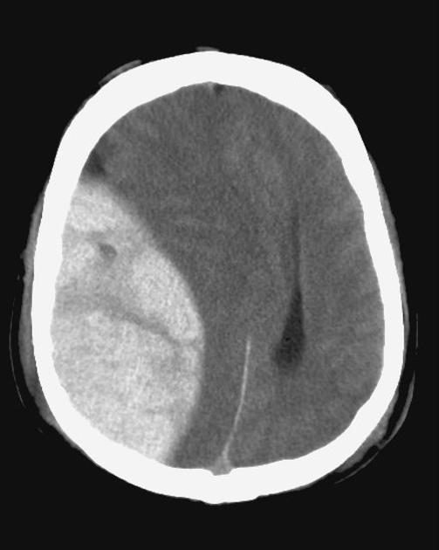
Automatic Image Captioning --> annotate imaging
Classification of radiology reports using neural attention models, IJCNN 2017
Notes:
This is a little different from what we’re talking about today – more akin to image processing, as the input is an image
And we are not going to talk about text generation.
But imagine possibilities here: Think: radiology report

Slide 16
Text Generation
SYSTEM PROMPT (HUMAN-WRITTEN)
A train carriage containing controlled nuclear materials was stolen in Cincinnati today. Its whereabouts are unknown.
MODEL COMPLETION (MACHINE-WRITTEN, FIRST TRY)
The incident occurred on the downtown train line, which runs from Covington and Ashland stations.
In an email to Ohio news outlets, the U.S. Department of Energy said it is working with the Federal Railroad Administration to find the thief.
“The theft of this nuclear material will have significant negative consequences on public and environmental health, our workforce and the economy of our nation,” said Tom Hicks, the U.S. Energy Secretary, in a statement. “Our top priority is to secure the theft and ensure it doesn’t happen again.”
The stolen material was taken from the University of Cincinnati’s Research Triangle Park nuclear research site, according to a news release from Department officials.
The Nuclear Regulatory Commission did not immediately release any information.
According to the release, the U.S. Department of Energy’s Office of Nuclear Material Safety and Security is leading that team’s investigation.
“The safety of people, the environment and the nation’s nuclear stockpile is our highest priority,” Hicks said. “We will get to the bottom of this and make no excuses.
“Better Language Models and Their Implications”
2/14/19
OpenAI
Notes:
Generative models based on transformer architecture and trained on 8 million webpages

Slide 17

Text Generation -> Suggested Email Responses
Notes:
Flooded with email
Not reimbursed
In the evening
Imagine a system that presents generated text that you can edit, or suggests multiple possible responses
Or “triages” messages to identify the important ones or categorize them
Seeing this happen with suggested responses in Gmail

Slide 18
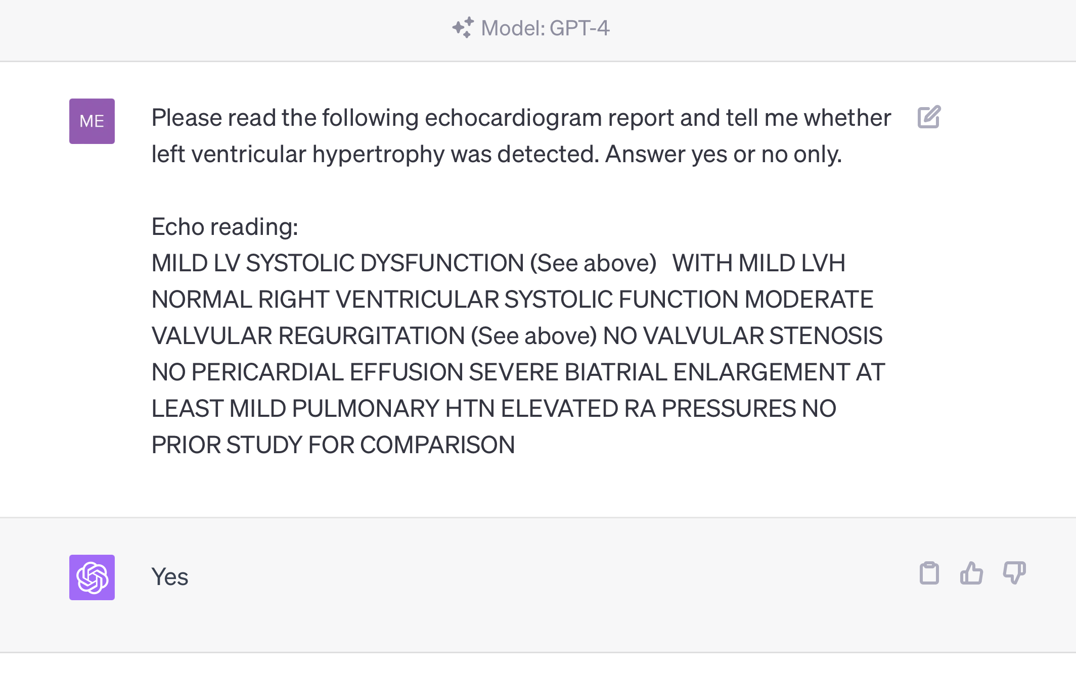
Are all tasks special cases of text generation?

Slide 19
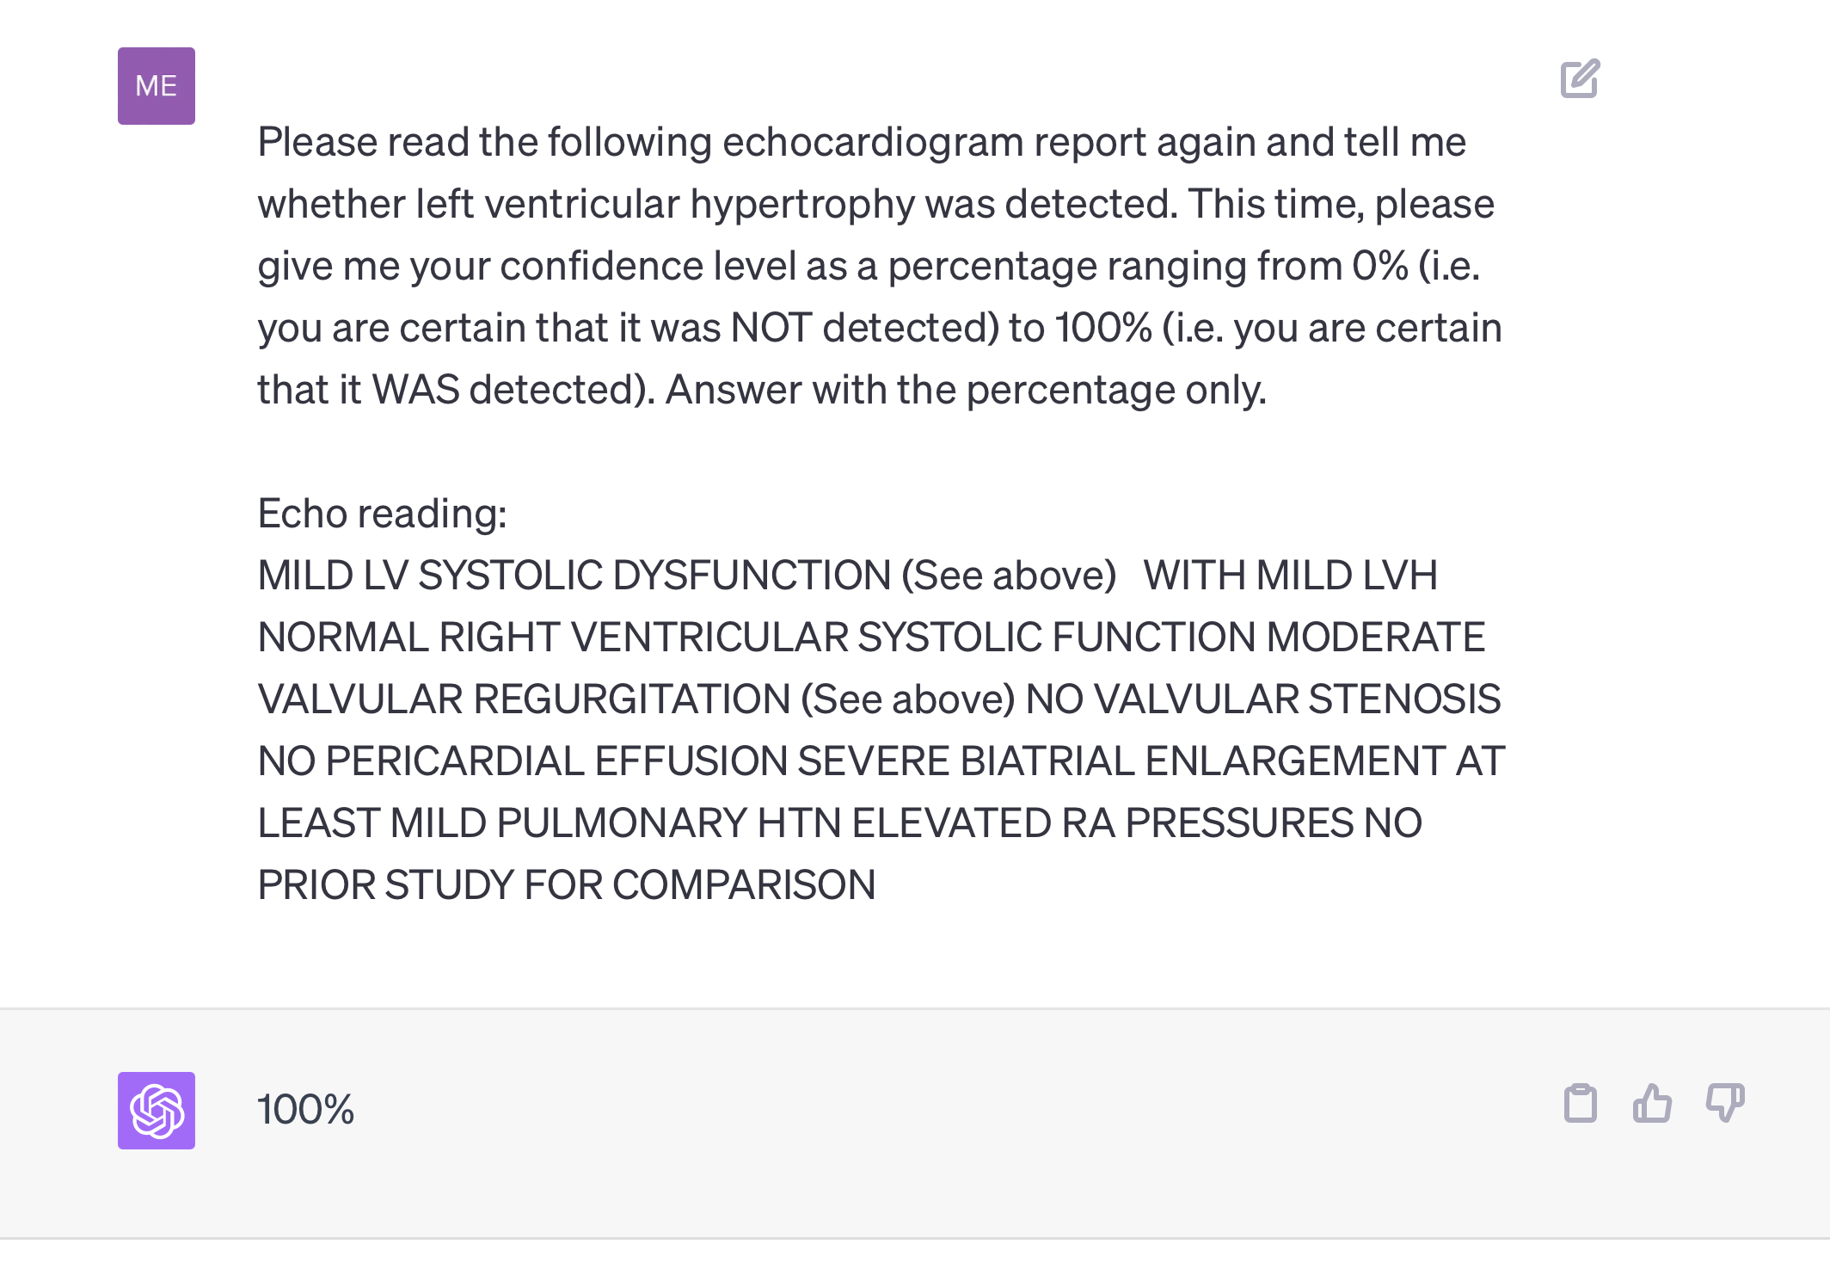
Are all tasks special cases of text generation?

Slide 20
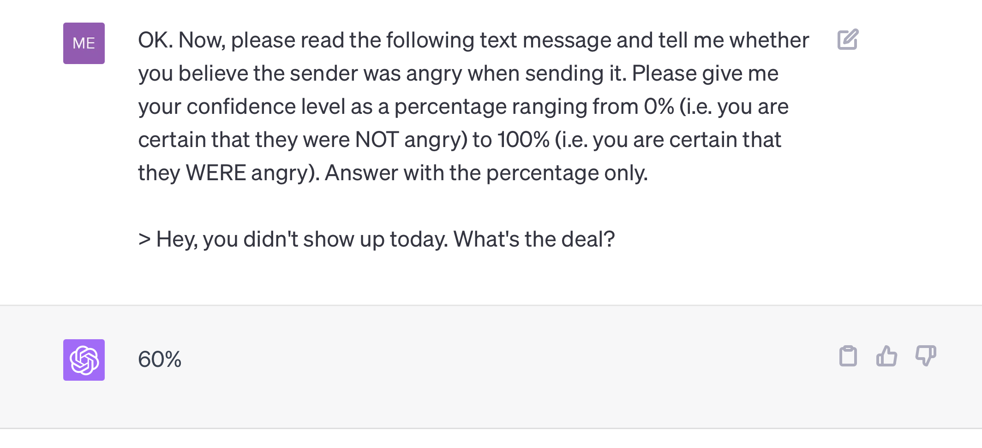
Are all tasks special cases of text generation?

Slide 21
How do we make predictions from text?
Answer 1: word counts

Slide 22
A Simple Predictive Model: ICU Mortality
???
WBC Count
Respiratory Rate
Creatinine
Mean BP
Hematocrit
Age
Temperature
Pulse Rate
Survival
End goal: predict odds of hospital mortality
Notes:
What goes in these boxes?

Slide 23
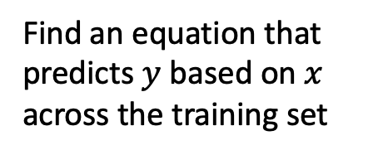
Training Set (Historical Data)
x₁
y₁
Find an equation that predicts $y$ based on $x$ across the training set
x₂
y₂
x₃
y₃
x₄
y₄
…
…
x_{N-1}
y_{N-1}
x_{N}
y_{N}
Notes:
How do we do that?
Gather a bunch of historical data
Want to find an equation that predicts y well based on x across that historical data
So we take all this data, we use it to find the parameters that are most consistent with the patterns of x and y that are present

Slide 24
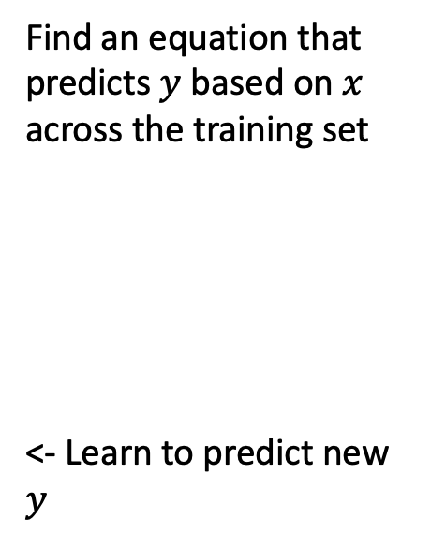

Making Predictions for New $x$
x₁
y₁
x₂
y₂
Find an equation that predicts $y$ based on $x$ across the training set
<- Learn to predict new $y$
x₃
y₃
x₄
y₄
…
…
x_{N-1}
y_{N-1}
x_{N}
y_{N}
x_{N+1}
y_{N+1}
Notes:
Having done that, we have a trained model.
Now, when we see a NEW value of x, we simply plug it into our “learned” equation, and it tells us what we expect y to be. This is prediction.

Slide 25
Case Study: SMS Triage for Global Maternal Health
https://www.praekelt.org
Can we use a standard predictive model
setup to solve this problem?

Slide 26
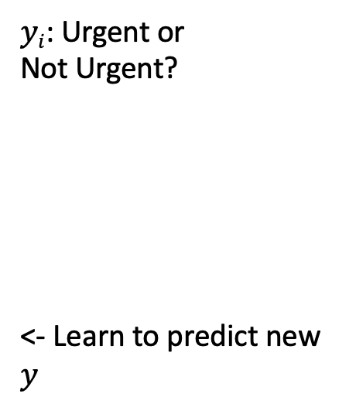
This time, our training data is text
x₁
What helps with morning sickness?
How many months should I breastfeed?
I passed out and Mom said I was shaking
Where is the nearest clinic?
I am having heavy bleeding, what should I do?
What foods should I eat while pregnant?
My heart is racing and I can’t catch my breath
y₁
x₂
y₂
x₃
y₃
$yi$: Urgent or
Not Urgent?
<- Learn to predict new $y$
x₄
y₄
…
…
x_{N-1}
y_{N-1}
x_{N}
y_{N}
x_{N+1}
y_{N+1}
Notes:
Having done that, we have a trained model. Our parameters are learned – we hold them fixed.
Now, when we see a NEW value of x, we simply plug it into our “learned” equation, and it tells us what we expect y to be. This is prediction.

Slide 27
We need numbers, not words
Can we convert our text to a vector or sequence of numbers?
If yes, we can use logistic regression (or any other predictive model)!

Slide 28
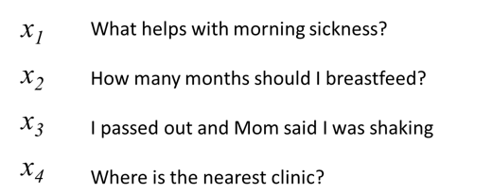
First try: count words in each SMS Step 1: Define a vocabulary of words
shaking
what
clinic
how
helps
was
nearest
many
with
said
months
the
morning
mom
should
sickness
and
I
is
how
out
breastfeed
passed
where
list of all words
(in no particular order)

Slide 29
Step 2: count how many times each vocabulary word appears in a given SMS
shaking
what
clinic
how
helps
was
nearest
many
with
said
months
the
morning
mom
should
sickness
and
I
is
how
out
breastfeed
passed
where
What helps with morning sickness?
x₁
0 | 1 | 0 | 0 | 1 | 0 | 0 | 0 | 1 | 0 | 0 | 0 | 1 | 0 | 0 | 1 | 0 | 0 | 0 | 0 | 0 | 0 | 0 | 0

Slide 30
Step 2: count how many times each vocabulary word appears in a given SMS
shaking
what
clinic
how
helps
was
nearest
many
with
said
months
the
morning
mom
should
sickness
and
I
is
how
out
breastfeed
passed
where
I passed out and Mom said I was shaking
x₃
1 | 0 | 0 | 0 | 0 | 1 | 0 | 0 | 0 | 1 | 0 | 0 | 0 | 1 | 0 | 0 | 0 | 2 | 0 | 0 | 1 | 0 | 1 | 0

Slide 31
Note that word order does not matter!
shaking
what
clinic
how
helps
was
nearest
many
with
said
months
the
morning
mom
should
sickness
and
I
is
how
out
breastfeed
passed
where
clinic is where nearest the
x₄
0 | 0 | 1 | 0 | 0 | 0 | 1 | 0 | 0 | 0 | 0 | 1 | 0 | 0 | 0 | 0 | 0 | 0 | 1 | 0 | 0 | 0 | 0 | 1

Slide 32

A “bag of words”
clinic
nearest
where
the
is

Slide 33
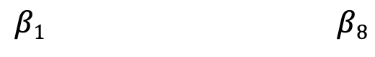
Now we can use logistic regression.
$$URGENCY LOG ODDS=β0+β1x1+β2x2+…$$
LOG ODDS
𝜎
y
shaking
clinic
morning
mom
sickness
breastfeed
passed
where
$$β1 β8$$
y, associated label:
(0 = not urgent, 1 = urgent)
x₁ | x₂ | x₃ | x₄ | x₅ | x₆ | x₇ | x₈

Slide 34
Variations on count-based feature extraction
Entirely data-driven
Vocabulary of words we care about is derived from the training data
We then represent text as counts of each vocabulary word
We can also count 2- and 3-word phrases; this helps with negation and context
Knowledge-driven extraction of key words or concepts
Rather than creating a vocabulary from the data, we can identify words we (or content experts) believe are important for a given task
Concept extraction systems (e.g. cTakes) will identify many alternative phrasings for the same clinical concept (e.g. diagnosis) and group them together as a single feature

Slide 35
Strengths and Weaknesses
(+) Count-based approaches are simple and work surprisingly well in practice
(+) Often the best approach with small datasets
(-) Does not capture word order
(-) Does not group synonyms together or understand semantic relationships between words

Slide 36
Summary
A central challenge of NLP lies in converting text documents into feature vectors that can be used in a predictive model
Bag of words models solve this challenge by constructing a feature vector based on counts of each word of interest
Even though they ignore word order and semantic relationships, these models are very powerful
Notes:
In summary…
Bag of words models solve this challenge by constructing a feature vector in which each element corresponds to a distinct word of interest, and its value is determined by counting the occorrences of that word in the document (or message, or passage)

Slide 37
Other text processing details
N-grams, tf-idf, pre-processing steps

Slide 38
Count 1- and 2-grams in each SMS (i.e. extend vocabulary to include 2-word phrases)
shaking
what
clinic
how
helps
was
nearest
many
with
said
months
the
morning
mom
should
sickness
and
I
is
how
out
breastfeed
passed
where
1-grams
what helps
helps with
with morning
morning sickness
how many
many months
months should
should I
I breastfeed
I passed
passed out
out and
and mom
mom said
said I
I was
was shaking
where is
is the
the nearest
nearest clinic
2-grams
Notes:
To make the model a bit more sensitive to word order, we can include short phrases in our vocabulary in addition to individual words
We call these n-grams: 2-word phrases are 2-grams, 3-word phrases are 3-grams, and so on.
This can be very helpful because, as an example, the phrase ‘morning sickness’ has a very specific meaning
Knowing that ‘morning sickness’ is present in the message tells us more than simply knowing that ‘morning’ is present, and ‘sickness’ is also present
The drawback of this approach is that it dramatically increases the size of our vocabulary, since there are many more possible 2- and 3-word combinations than there are individual words
For this reason, we often consider 2-grams, sometimes consider 3-grams, and rarely consider 4-grams or beyond.

Slide 39
n-grams can be very helpful!
I am not sick and feel great
Bag of 1-grams: no difference between these sentences
I am not great and feel sick
Notes:
2-grams are particularly helpful in making sense of sentences that contain negation.
Consider the following two sentences:
“I am not sick and feel great”
And
“I am not great and feel sick”
These sentences have opposite meanings, yet their bag of words representations are the same

Slide 40
n-grams can be very helpful!
I am not sick and feel great
Bag of 1- and 2-grams:
not sick, feel great
versus
not great, feel sick
I am not great and feel sick
Notes:
However, if we include 2-grams, we find that the representations are now different:
The first sentence contains the 2-gram ‘not sick’ and the 2-gram ‘feel great’
Whereas the second sentence contains the 2-gram ‘not great’, and ‘feel sick’
The predictive model based on these representations can then learn that ‘not sick’ and ‘feel great’ are positive, for example, whereas ‘not great’ and ‘feel sick’ are negative.

Slide 41
Variations on counting: term frequency
term count: ‘times’
“It was the best of times, it was the worst of times, it was the age of wisdom, it was the age of foolishness, it was the epoch of belief, it was the epoch of incredulity, it was the season of Light, it was the season of Darkness, it was the spring of hope, it was the winter of despair, we had everything before us, we had nothing before us, we were all going direct to Heaven, we were all going direct the other way—in short, the period was so far like the present period, that some of its noisiest authorities insisted on its being received, for good or for evil, in the superlative degree of comparison only.”
2
“And the first one now Will later be last For the times they are a-changin'.”
1
Notes:
Consider the two passages in this slide
The word ‘times’ appears in both passages
-- twice in the first, and once in the second
However, since the first passage is much longer, we might argue that the word ‘times’ is more important to the second passage than the first

Slide 42
Variations on counting: term frequency
term frequency: ‘times’
“It was the best of times, it was the worst of times, it was the age of wisdom, it was the age of foolishness, it was the epoch of belief, it was the epoch of incredulity, it was the season of Light, it was the season of Darkness, it was the spring of hope, it was the winter of despair, we had everything before us, we had nothing before us, we were all going direct to Heaven, we were all going direct the other way—in short, the period was so far like the present period, that some of its noisiest authorities insisted on its being received, for good or for evil, in the superlative degree of comparison only.”
2/119
“And the first one now Will later be last For the times they are a-changin'.”
1/16
-> better measure of the importance of
the term within a given text sample
Notes:
To quantify this idea, instead of simply counting occurrences of each word, we can instead calculate their term frequency, defined as the number of occurrences divided by the total number of words in the passage
When we do this, we see that the term frequency for ‘times’ is higher in the second passage than in the first.

Slide 43
Variations on counting: inverse document frequency
2/2
document frequency: ‘times’
“It was the best of times, it was the worst of times, it was the age of wisdom, it was the age of foolishness, it was the epoch of belief, it was the epoch of incredulity, it was the season of Light, it was the season of Darkness, it was the spring of hope, it was the winter of despair, we had everything before us, we had nothing before us, we were all going direct to Heaven, we were all going direct the other way—in short, the period was so far like the present period, that some of its noisiest authorities insisted on its being received, for good or for evil, in the superlative degree of comparison only.”
✔
✔
“And the first one now Will later be last For the times they are a-changin'.”
Notes:
Another thing we might notice is that words that appear in every passage we might consider – words like ‘the’, ‘in’, and ‘was’
Are probably not very important even though their term frequency is often high
To quantify this idea, we can look at the document frequency – the proportion of the passages, or documents, in which a given word appears
Looking at these two passages, the word ‘times’ appears in both, so its document frequency is 2 of 2

Slide 44
Variations on counting: inverse document frequency
1/2
document frequency: ‘evil’
“It was the best of times, it was the worst of times, it was the age of wisdom, it was the age of foolishness, it was the epoch of belief, it was the epoch of incredulity, it was the season of Light, it was the season of Darkness, it was the spring of hope, it was the winter of despair, we had everything before us, we had nothing before us, we were all going direct to Heaven, we were all going direct the other way—in short, the period was so far like the present period, that some of its noisiest authorities insisted on its being received, for good or for evil, in the superlative degree of comparison only.”
✔
X
“And the first one now Will later be last For the times they are a-changin'.”
Notes:
On the other hand, the word ‘evil’ only appears in one of the two passages, so its document frequency is ½
Since ‘evil’ appears in fewer passages – fewer documents – our intuition is that its appearance is probably meaningful, so we want to increase the size of the corresponding feature
We want to deemphasize words that appear in all passages and emphasize words that only appear in a few
In other words, we want to weight our features by the inverse of the document frequency

Slide 45
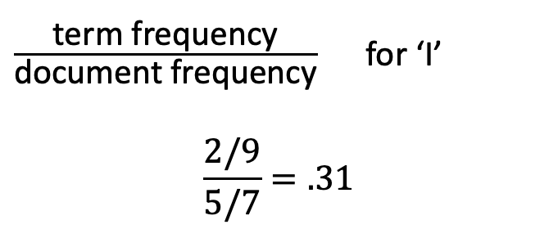
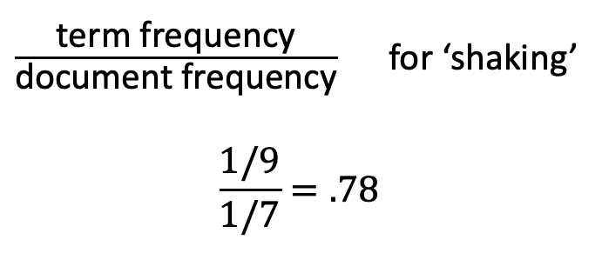
term frequency-inverse document frequency (tf-idf)
What helps with morning sickness?
How many months should I breastfeed?
I passed out and Mom said I was shaking
Where is the nearest clinic?
I am having heavy bleeding, what should I do?
What foods should I eat while pregnant?
My heart is racing and I can’t catch my breath
$\frac{\text{term} \text{frequency}}{\text{document} \text{frequency}}$ for ‘shaking’
$$\frac{1/9}{1/7}=.78$$
$\frac{\text{term} \text{frequency}}{\text{document} \text{frequency}}$ for ‘I’
$$\frac{2/9}{5/7}=.31$$
Notes:
Putting these two ideas together, we get a modified version of the bag of words features discussed before –
It’s called term-frequency inverse document frequency, or tf-idf
Let’s look at the tf-idf feature for ‘shaking’ in the sentence highlighted in red
There are 9 words in the sentence, and shaking appears once, so its term frequency is 1 over 9
Looking at the document frequency, this word appears in only one of the seven sentences, so its document frequency is 1 over 7
If we multpily the term frequency by the inverse document frequency – which is another way to say to divide the term frequency by the document frequency –
We get 1 over 9 divided by 1 over 7, which is 7/9ths, or .78
Let’s contrast that with the tf-idf feature for ‘I’ in the same sentence. Since ‘I’ appears twice in that sentence, its term frequency is higher – 2/9ths.
However, since ‘I’ appears in 5 of the 7 sentences, its document frequency is also much higher – 5/7, resuting in a tf-idf feature of .31, much lower than the feature for ‘shaking’

Slide 46
Preprocessing
I passed out, and Mom said I was shaking.
remove punctuation
to lowercase
“tokenization”
“stemming”
I passed out and Mom said I was shaking
i passed out and mom said i was shaking
[i, passed, out, and, mom, said, i, was, shaking]
[i, pass, out, and, mom, said, i, wa, shake]
Notes:
There are a few other steps required to convert documents to features that are conceptually simple, but important
We’ll go over these in more detail in our computational exercise
Typically we begin by removing punctuation from our sentences and converting all words to lowercase
We don’t want capitalized words to be considered to be different words from their non-capitalized counterparts, for example
Once that’s done, we can split sentences on whitespace so that we can count the individual words
This isn’t meaningful on paper, but is important when implementing the process in code
Finally, in some cases we may also want to use stemming, which removes the endings of words so that ‘pass’ and ‘passed’ correspond to the same feature, for example
Alternatively, you may hear about lemmatization, which is very similar to stemming, but incorporates a bit more linguistic knowledge

